Slide 1


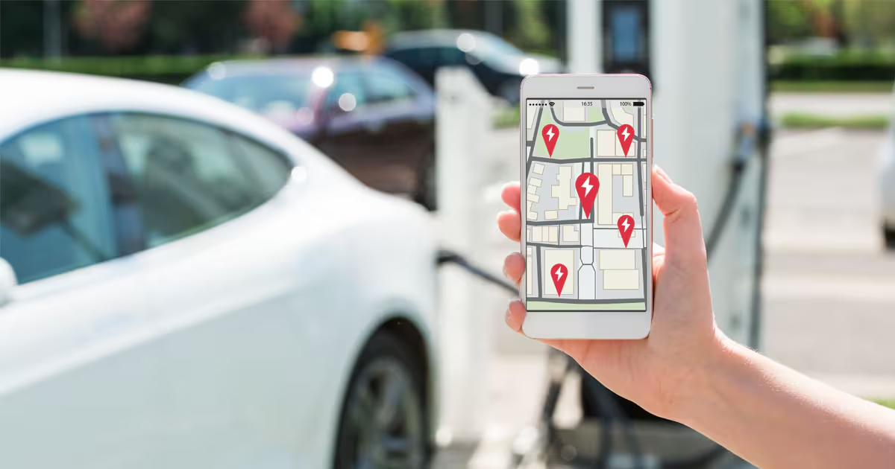
ELECTRIC CHARGING
STATIONS MAPPING
Shay Shalev 211783519
Adi Matok 212917926
Roni Lubashevski 318917556

Slide 2

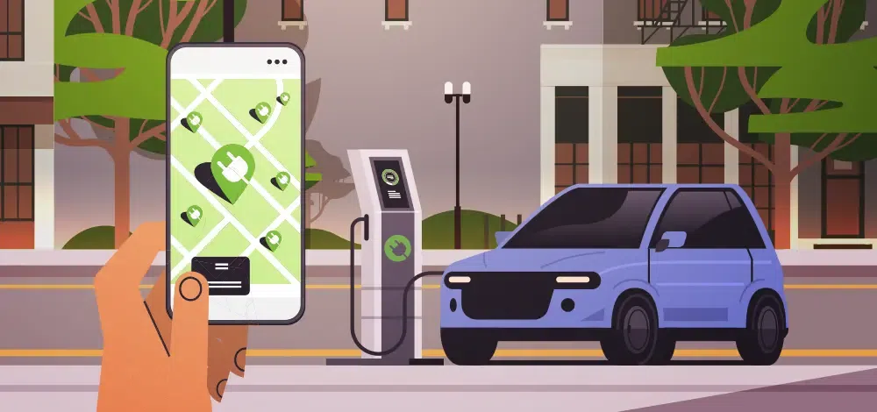

ABOUT OUR PROJECT
Our project is designed to help electric vehicle
drivers quickly and intuitively locate charging stations across the country.
Using an interactive map, users can filter stations
based on location, plug type, and distance from their current position.
The system enables flexible searches and highlights the most relevant stations according to user needs.
Our goal is to provide a practical tool for drivers who need to charge on the go, ensuring convenient access to charging stations.

Slide 3





PROGRAMMING LANGUAGES & DEVELOPMENT ENVIRONMENTS
PROGRAMMING LANGUAGES:
DEVELOPMENT ENVIRONMENTS:
LIBRARIES & TOOLS:
HTML – Defines the application structure.
CSS – Handles design and layout.
JavaScript – Adds interactivity and logic.
Leaflet.js – Manages the interactive map.
OpenStreetMap – Provides map data.
Geolocation API – Retrieves user location.
Web Browser – Used for testing.
GitHub – For version control and collaboration.

Slide 4
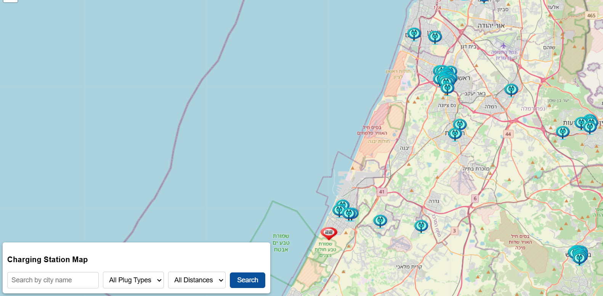
PROJECT OVERVIEW
The map in our application allows users to view their current location and find EV charging stations across the country.
By clicking on the buttons in the search bar, users can filter stations based on city name, plug type, or distance from their location.
This interactive tool provides a simple and efficient way to locate nearby charging stations.

Slide 5

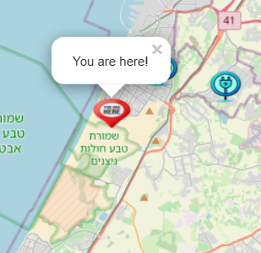
MY
LOCATION
The map now requests the user's location immediately upon accessing the application, ensuring an optimal user experience. By granting location access, users can instantly view their current position marked on the map with the "You are here!" icon. This feature helps users to easily identify charging stations in their vicinity.

Slide 6

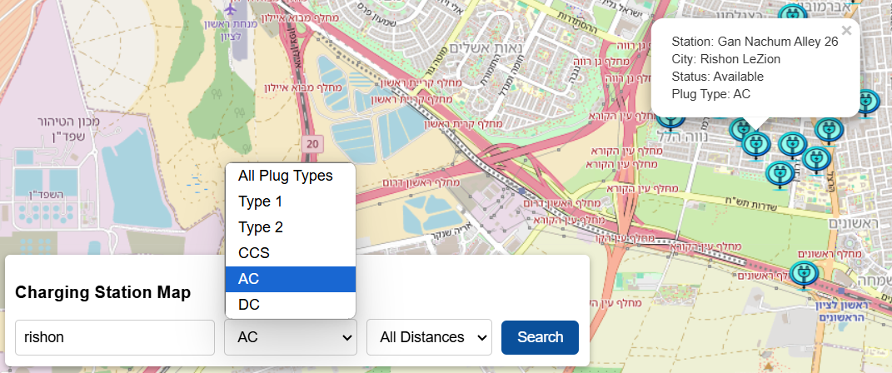
IN OUR MAP APPLICATION, USERS CAN SEARCH FOR ELECTRIC VEHICLE CHARGING STATIONS BASED ON SPECIFIC CITIES, CHARGING TYPES SUCH AS TYPE 1, TYPE 2, AC, DC, OR CCS, AND A RADIUS AROUND THEIR CURRENT LOCATION.
Job Position

Slide 7
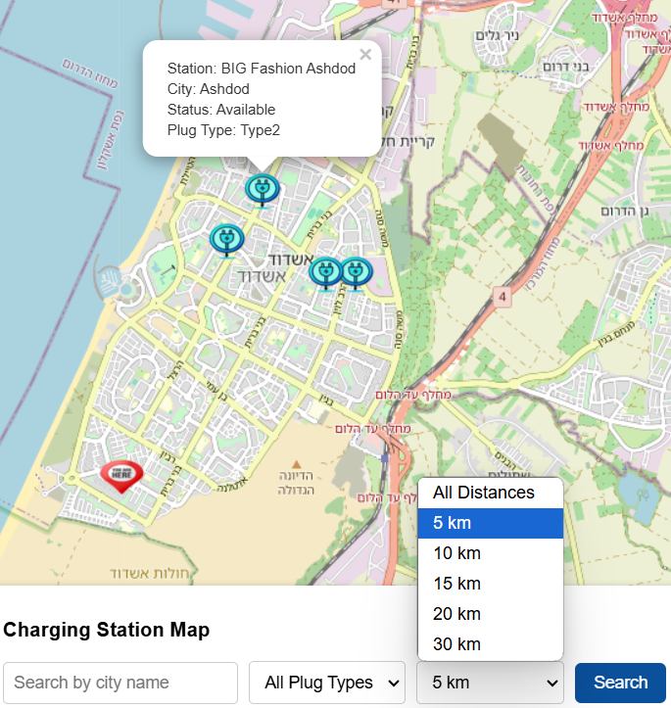


THE APPLICATION AUTOMATICALLY DETECTS THE USER'S CURRENT LOCATION UPON LOADING, THIS FEATURE DISPLAYS THE USER'S POSITION ON THE MAP WITH A "YOU ARE HERE!" MARKER. ADDITIONALLY, USERS CAN FILTER NEARBY CHARGING STATIONS BASED ON A SPECIFIC DISTANCE FROM THEIR LOCATION, ALLOWING FOR EASY ACCESS TO RELEVANT OPTIONS WITHIN A DEFINED RANGE.

Slide 8

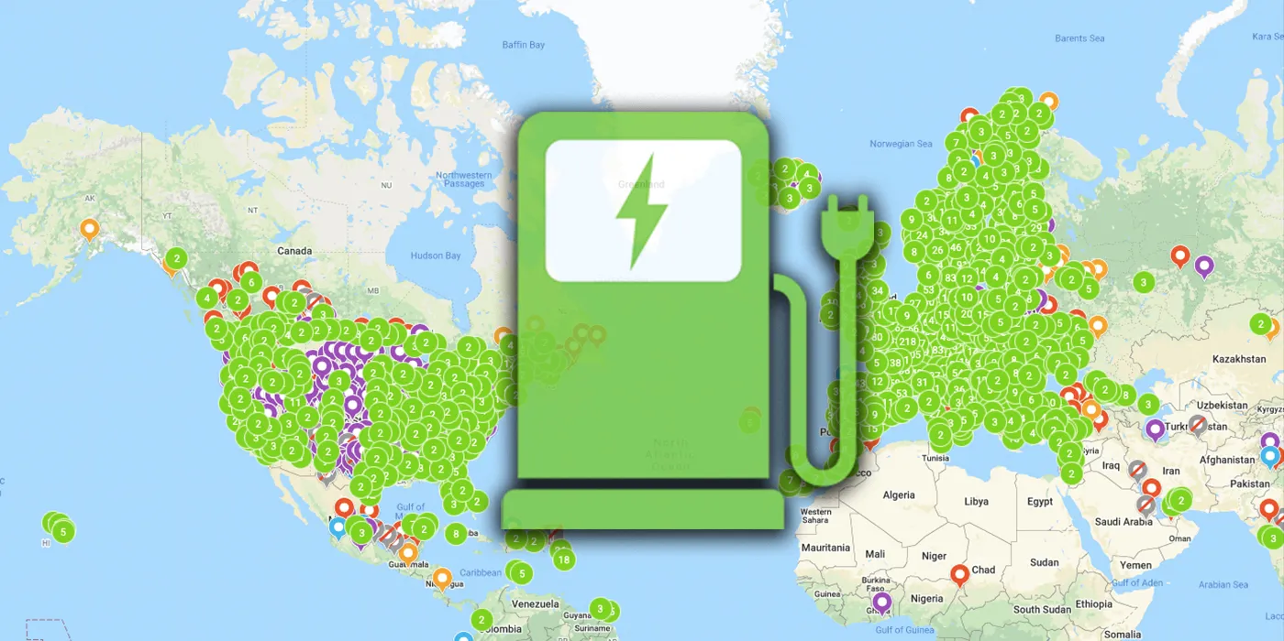
PROJECT LINK: https://100adim.github.io/GIS-PROJECT/
THANK
YOU

